Slide 1

Movie Sales Analysis
Presented by:
Shivaramaraju Alle
Sony Chamakoura
Batch : 442

Slide 2
Agenda:
Business Problem
Business Objective
Problem Statement
Dataset Overview
Data Cleaning & Transformation
Dashboard Visualization
Dashboard Highlights
Key Insights
Recommendations
Challenges Faced
Conclusion

Slide 3
Business Problem :
Movie industry generates huge volumes of data
Manual analysis is time-consuming
Revenue success factors are unclear
Difficulty in identifying profitable genres
Challenges in evaluating director performance
Lack of insights into audience engagement
Need for centralized analytical solution

Slide 4
Business Objective :
Analyse IMDb movie dataset
Understand box-office performance trends
Identify high-performing genres
Analyse director-wise revenue contribution
Study impact of ratings and votes
Support strategic movie investments
Build interactive Power BI dashboard

Slide 5
Problem Statement
Lack of a consolidated view of movie performance across multiple years.
Difficulty in tracking revenue growth and decline trends over time.
Limited ability to compare movie success across genres and ratings.
Absence of clear metrics to measure audience response and popularity.
Challenges in identifying top-performing movies and industry leaders.
Inadequate visualization tools to support strategic planning.
Need for a data-driven system to support informed business decisions.

Slide 6
Dataset Overview :
Total Rows :1000
Total Columns:12
Rank : The position of the movie in the ranking list.
Title : The name of the movie.
Genre : The primary genre(s) of the movie (e.g., Action, Drama).
Description : A brief summary or synopsis of the movie plot.
Director : The name of the movie’s director.
Actors : Names of the main actors featured in the movie.
Year : The year the movie was released.
Runtime (Minutes) : Duration of the movie in minutes.
Rating : The average viewer rating (e.g., IMDB rating).
Votes : Total number of user votes received for the movie.
Revenue (Millions) : Total revenue generated by the movie in millions of USD.
Metascore : The Metacritic score representing critic reviews (0–100 scale).

Slide 7
Data Cleaning & Transformation :
Checked for missing values
Handled null Revenue values
Handled null Metascore values
Used average-based imputation
Validated numerical columns
Corrected data types
Prepared data for visualization

Slide 8
Dashboard Visualization :
User-friendly and interactive layout
Year-wise revenue trends
Genre-wise revenue comparison
Top 10 movies by revenue
Director performance analysis
Rating vs Revenue relationship
Runtime vs Revenue insights
Dynamic filters and slicers

Slide 9
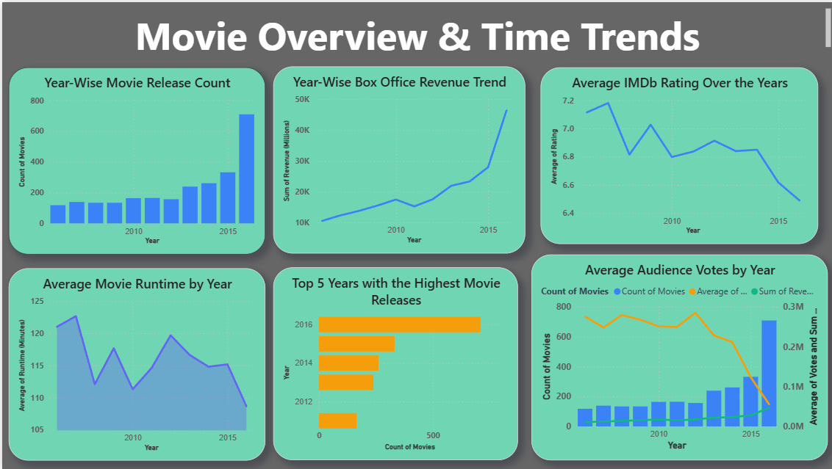
Dashboard :

Slide 10
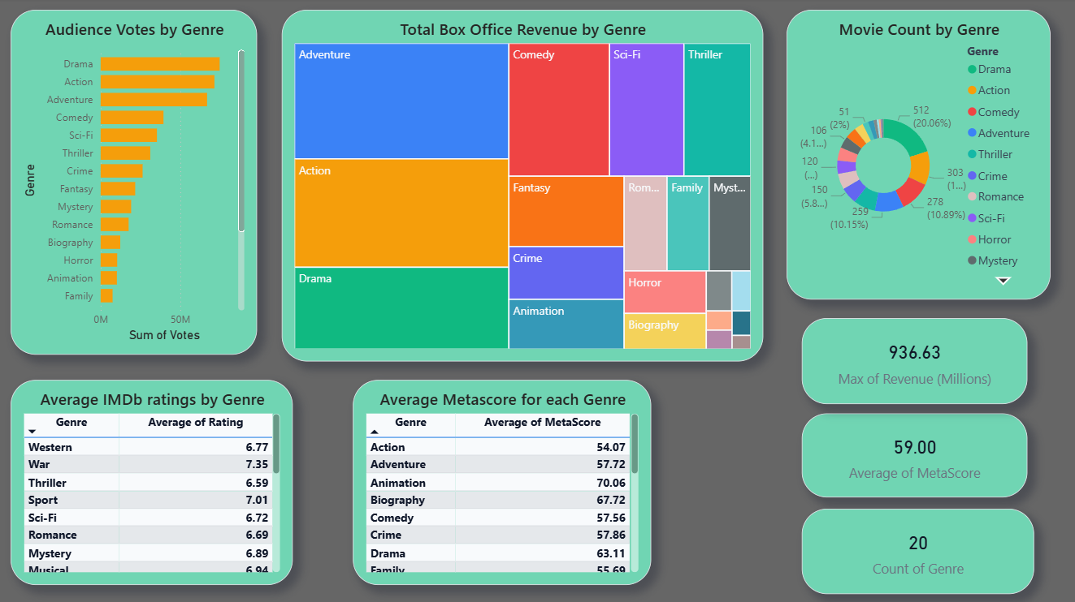

Slide 11
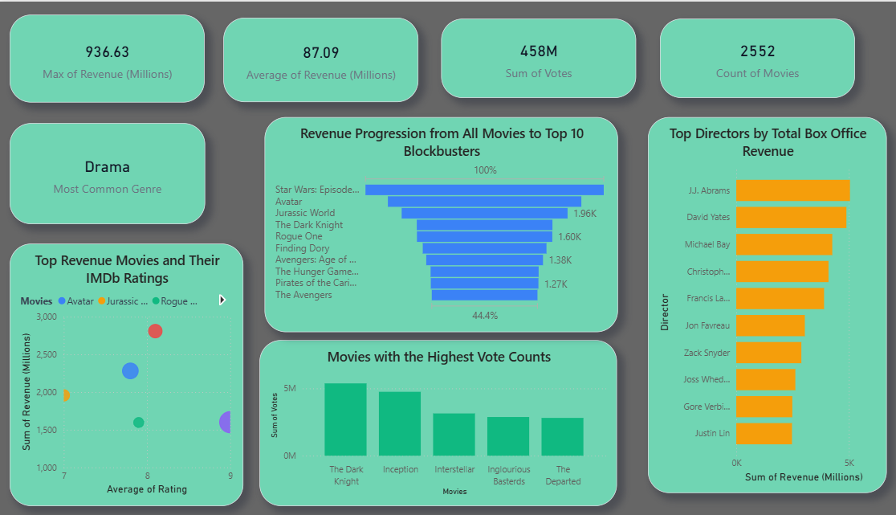

Slide 12
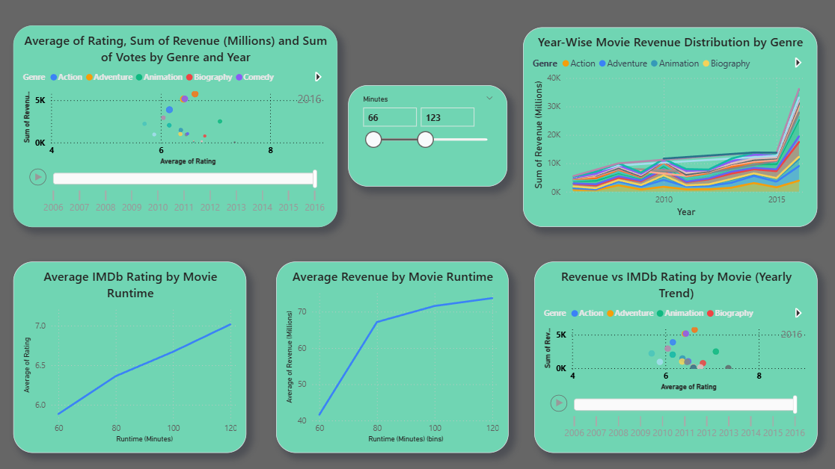

Slide 13
Key Insights :
Higher-rated movies earn more revenue
Action and Drama are top-performing genres
Some directors consistently deliver hits
Movies with moderate runtime perform better
Audience votes strongly influence success
Balanced content attracts wider audiences

Slide 14
Recommendations
Focus production and marketing efforts on high-performing genres such as Action and Drama.
Invest in directors with a consistent record of high box office revenue.
Prioritize movies with strong audience engagement, as votes significantly influence revenue.
Target optimal movie runtimes to maximize audience retention and revenue.
Balance content quality and commercial appeal to achieve both high ratings and revenue.
Use data-driven insights for budgeting, casting, and release timing decisions.
Continuously monitor performance trends using interactive dashboards for better planning.

Slide 15
Challenges Faced :
Missing & Incomplete Data
Complex relationship between Columns
Selecting relevant KPIs
Designing clear visuals

Slide 16
Conclusion :
Dashboard converts raw data into insights
Provides holistic view of movie performance
Helps identify revenue-driving factors
Supports production and marketing decisions
Encourages data-driven planning
Useful for studios and streaming platforms

Slide 17

THANK YOU

